Slide 1
SCOPUS: 55 million records and counting
五千五百万条记录, 还在继续…
程赛鹤
Elsevier 科研管理咨询顾问
c.cheng@elsevier.com

Slide 2
大纲
一、Research Intelligence介绍
二、Scopus目前使用情况介绍
三、Scopus 功能介绍
Scopus分析和评估功能介绍
Scopus的人名清理和评估

Slide 3
一、Research Intelligence介绍

Slide 4















爱思唯尔致力与用其数据信息来服务科研工作
Worlds Largest
Scholarly Publisher
Research Data Services
and Analytics
Notes:
我们通过提供技术应用及内容分析服务为科研、学术与临床领域奉献力量。
通过研究智能工具、分析Scopus引用数据库数据，我们帮助机构和政府领袖深入分析科研业绩与能力，推动他们做出明智投资决策。
我们改进了科学家、学生、医生与护士教学及学习的方式，提高他们的工作效率
Clinical Key和Mendeley等产品帮助研究者和专业人员改进互动、共享与应用信息的方式。

Slide 5
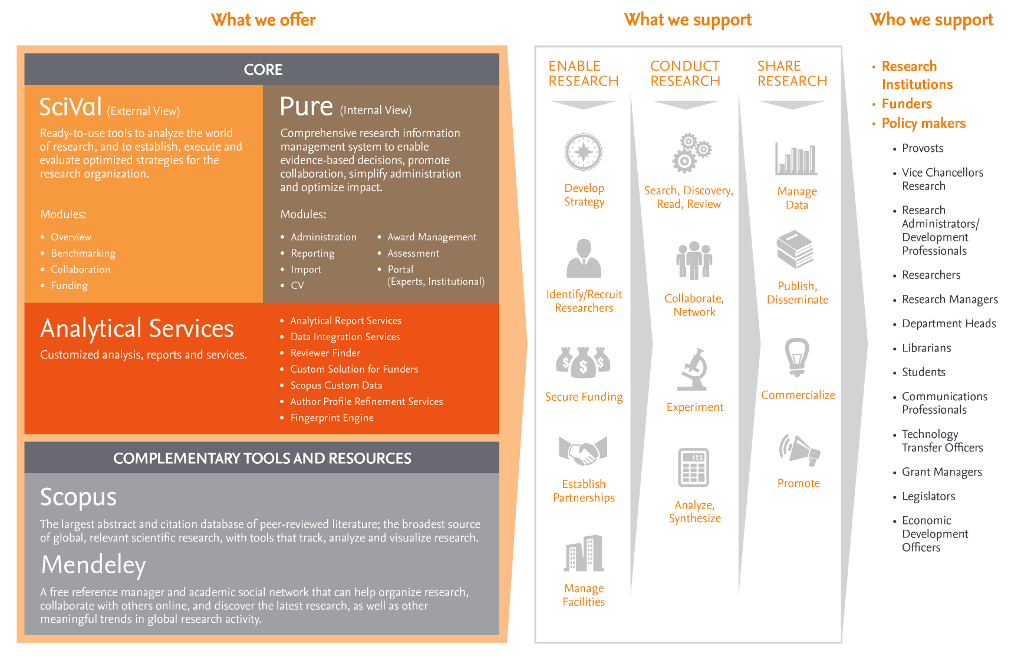
爱思唯尔科研管理系列工具
www.elsevier.com/research-intelligence
Notes:
爱思唯尔是全球领先的智能信息服务提供商，SciVal是爱思唯尔旗下的产品，为我们提供科学与技术领域的信息服务，帮助我们的用户更快地作出最明智的决策。
Scival为科研机构提供以下两种不同的情报（信息或决策等）服务。
首先，SciVal能够宏观的展示科研机构（大学或研究所等）的科研现状，通过独特的基准分析，得出科研机构的竞争优势和劣势；
其次，Pure采用爱思唯尔旗下统一可靠的出版（或文献或情报或Scopus）数据对科研机构进行深入情报分析。
我们提供三种独特的揭示科研活动的功能：
SciVal， 是在了解全球科研的情况下，对某科研机构进行对比分析和基准测评；
Pure，利用独特的专家分析工具，通过统一平台，展示科学家或科研机构的整体科研信息，并以此提供在全球开展国际科研合作的相关信息和机会；
Analytical Services，我们根据特殊需求，提供个性化的分析报告服务。以及希望将Scopus Custom Data用于自身数据库的客户。
此外，我们还提供其他补充服务，如Profile Refinement Services，致力于提高各作者名下出版物信息的准确性；以及Fingerprint Engine，处理非结构化文本，编纂一系列加权关键概念型信息。

Slide 6
二、 Scopus简介

Slide 7
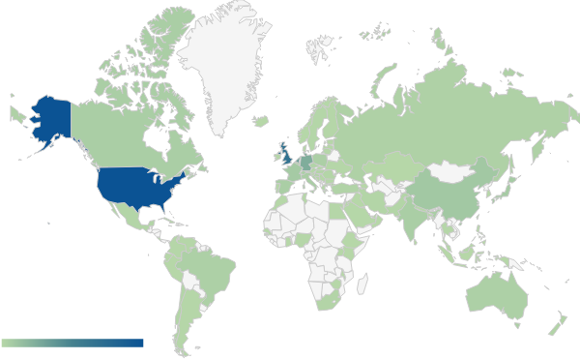
Scopus-全球最大的文摘与引文数据库
Scopus数据库是全球最大的文献摘要与科研信息引用数据库，拥有5500多万条记录，每日更新包括：
  来自5,000多家国际出版商的21,915期刊，含20,000多种同行评议期刊
  2,800份黄金开放获取访问期刊
  3750种在编期刊（先于发表1-4个月获取）
  49,000+本图书（到2015年将增加至75,000本）
  超过640万份会议论文
  390余种商业出版物
  超过400本丛书
  覆盖的刊物超过40多种语言，含500余种中文同行评议的期刊，远多于其他国际同行
Scopus是进行科研输出检索，分析和评估的全面有效的数据源。
Notes:
Besides subject areas, Scopus also has breadth of coverage across different geographical areas. Based on the physical location of the publisher of a title, most titles in Scopus originate from North America and Western-Europe. This is not surprising, since this is also the location where most major publishers that produce the majority of scientific titles are located. However, Scopus covers titles from almost all global regions and specifically countries like the Russian Federation, China, India, Australia, Brazil and South Africa have a significant number of titles covered in the database.
Scopus 数据库面向高校、科研机构以及企业研发部门，为最终用户进行科研输出的搜索、分析和评估提供了一个全面、有效的数据源：

Slide 8




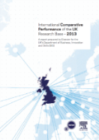

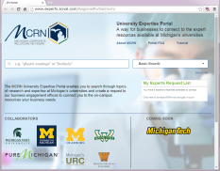


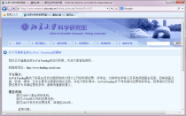
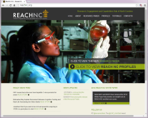
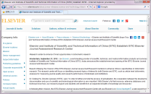

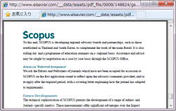
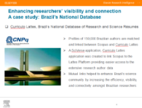
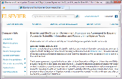
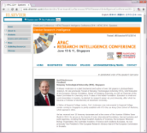

提供全方位的科研咨询服务…..
Russian Foundation
of Basic Research
UK REF
Kiel
University
Queen’s University Belfast
UK BIS
Ural Federal University
Michigan Corporate Relations Network
STINT
MD Anderson
Danish BFI
Germany IFQ
OECD
FCT Portugal
Keio
University
Italy ANVUR
Gazi
University
ReachNC
ISTIC
Peking University
IISER
ECSAC-
Thailand
ECSAC-Korea
Nanyang Technological University
Nigerian
Government
CAPES Brazil
ERA 2012
Notes:
Elsevier Research Intelligence is used by the world’s research leaders to assess their research strengths and inform decision making. We take a consultative approach, working in partnership with individual institutions to meet their specific needs, and here are some examples just to name a few.
<Description of client examples to choose from>
In the US, Michigan and ReachNC use Pure hosted edition to connect their resources with industry sector. MD Anderson use Pure hosted edition to accelerate collaboration with their sister institutions which are spread across the world to fight cancer.
OECD and QS use Scopus Custom Data. So does IFQ, to analyze German and international research to establish government funding policies.
UK Business, Innovation and Skills Dept (BIS) commissioned the international comparative study to Analytical Services to assess the UK’s research base and trends that many affect its future standing.
Scopus is used for research assessment by many countries including Italy, Australia (ERA) and UK (REF). For ERA and REF, web integrated platforms were built by the Analytical Services team for research institutions to submit their publications associated with various impact measures.
The national funding agency for science and technology in Portugal, Fundação para a Ciência e aTecnologia (FCT), selected Analytical Services, using Scopus as its data source, to provide research metric analyses that will support its 2013/14 national review assessment of R&D units.
All Danish universities use Pure to submit their research outcomes to be used as part of Danish BFI model - performance based research funding systems. Pure (REF module) is also used by UK institutions to prepare and manage their REF submissions.
Scopus links with Curriculo Lattes (CAPES), Brazil's national research database of research and science résumés, to enhance profiles of Brazilian researchers.
In Russia, Russian Foundation of Basic Research Chooses Elsevier’s Scopus to Improve Russia’s Research Ranking Position; Ural Fed Univ signed Pure agreement to increase the quality and quantity of its research output with the aim of improving its position in the world research rankings.
The Association of Vice-Chancellors of Nigerian Universities (AVCNU) on behalf of the Nigerian Government, signed Scopus and SciVal agreement which provides access to 79 government funded academic institutes to measure the quality and impact of research, and to gain insights on how to raise Nigeria’s visibility within the global scientific landscape.
Kiel University use SciVal to enhance its research strength by bolstering its four principal areas of excellence in research through increasing collaboration with like-minded universities around the world and ensuring recruitment and retention of key researchers.
Keio University used SciVal and Pure hosted edition to build on its core research strengths. Together with Elsevier, Keio University launched a research expansion project to identify investigators who could serve as catalysts to increase multidisciplinary collaboration, and to seek new research areas.
Nanyang Technological University use SciVal and Pure hosted to analyze their research and build strategy to improve their university ranking and their strong position in research and education.
Peking U research office use SciVal Funding and Pure hosted. SciVal Funding is used by students to explore scholarship and exchange opportunities, by researchers to learn past awards and to seek new ones outside of China which they can apply for, and for research managers to track and analyze the recent trend of international research funding.
Gazi University promote university-wide access of SciVal to improve science infrastructures for researchers, and encourage them to track trends and analyze their research performance to contribute to the country and the world of science.
There are local board for Scopus in Korea and Thailand know as: Expert Content Selection & Advisory Committee of Korea (ECSAC-Korea) and ECSAC-Thailand.
Join the world’s leading universities, research institutes, funders and policymakers who rely on Elsevier Research Intelligence to solve problems and expand capabilities to advance their research excellence
Research institution: We provide a comprehensive portfolio of research management solutions designed to provide a sharp, panoramic view of your institution’s research activities.
Founders: We can help funders assess the effectiveness of the research projects they fund, find reviewers and identify trends across key research areas.
Policy-Makers: We provide the tools to help you assess research performance and collaboration trends, determine the effectiveness of research policies and showcase research excellence.

Slide 9








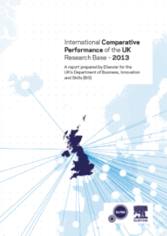
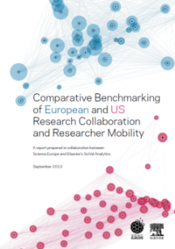

Scopus-3000多家机构都在使用
Australian Research Council
Non-Scopus
Scopus
Institute | Country
Massachusetts Institute of Technology | US
Harvard University | US
University of Cambridge | UK
University College London | UK
Imperial College London | UK
University of Oxford | UK
Stanford University | US
Yale University | US
University of Chicago | US
California Institute of Technology | US
Princeton University | US
ETH Zurich | CH
University of Pennsylvania | US
Columbia University | US
Cornell University | US
Johns Hopkins University | US
University of Edinburgh | UK
University of Toronto | CA
Ecole Polytechnique Federale de Lausanne | CH
King’s College London | UK

Slide 10


自2015年，THE开始采用Scopus的数据和SciVal的分析指标进行全球学校排名。

Slide 11
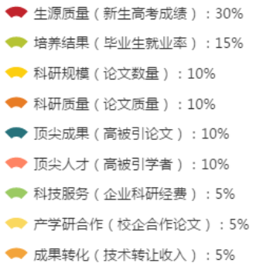
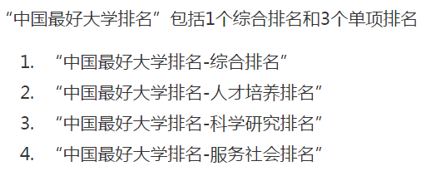
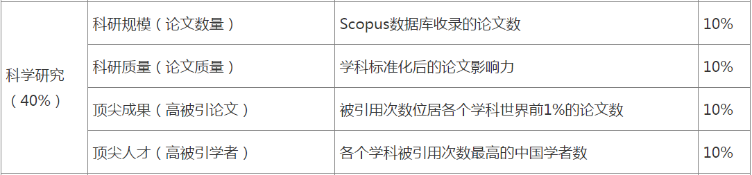
‘2015最好大学排名’
http://www.zuihaodaxue.com/
上海交大2月排名发布中国最好大学网，采用Scopus数据源。

Slide 12
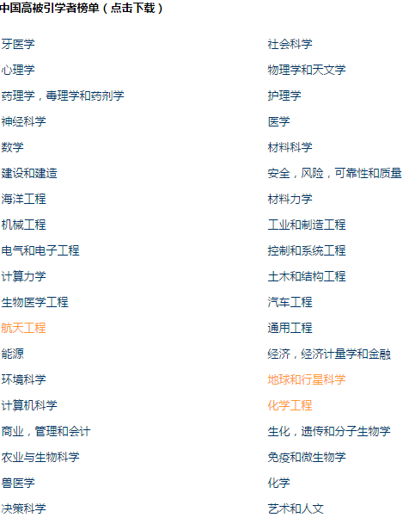
2014年中国高被引学者榜单发布
顶尖人才（高被引学者）
指各个学科被引用次数最高的中国学者（Most Cited Researchers in China，简称高被引学者）数。高被引学者总人数1650人左右，各学科的人数分布根据各学科论文中出现的中国作者数量的分布确定。高被引学者的筛选标准客观统一，从纯学术影响力的角度给出了中国的高被引学者名单。大学的高被引学者数量体现了学校拥有的各个学科的最具影响力的人才情况。
统计方法：（1）列出各个学科的论文地址中曾经包括中国（大陆）机构的所有作者，并按总数2000人和各学科所有中国（大陆）机构作者数量的分布计算出各学科在2000人中的名额分配；（2）在各个学科按相应名额筛选出作为通讯作者或第一作者发表的论文被引总次数排名最高的作者名单；（3）排除从未发表过被引次数世界前1%论文且FWCI低于1（世界平均水平）的作者；（4）排除现职工作单位是中国（大陆）以外机构的作者。
数据来源：Scopus数据库。
网络链接：china.elseveri.com

Slide 13
Scopus内容概述
Physical
Sciences
6,600
JOURNALS
21,915 peer-reviewed journals
367 trade journals
- Full metadata, abstracts and
cited references (pre-1996)
- >2,800 fully Open Access titles
- Going back to 1823
- Funding data from
acknowledgements
CONFERENCES
17k events
5.5M records (10%)
Conf. expansion:
1,000 conferences
6,000 conf. events
400k conf. papers
5M citations
Mainly Engineering and Physical Sciences
BOOKS
421 book series
- 28K Volumes
- 925K items
29,917 books
- 311K items
Books expansion:
75K books by 2015
- Focus on Social Sciences and A&H
PATENTS
24M patents
from 5 major
patent offices
Health
Sciences
6,300
Social
Sciences
6,350
Life
Sciences
4,050
Notes:
Scopus包括journals， conferences, Books,和patents。
另外我们在三个方面具有卓越的优势：包含EI的全部内容，比如在Engineering 方面的收录的内容比其他竞争对手多70%的内容，computer science方面，Scopus总共收录了1639种title的期刊，其中1523种是Scopus数据库独有的，其中1586%(58/67) of rank 1 conferences covered by Scopus ，business management方面的收录比其他同行多出80%的期刊收录，金融时报采用Scopus的数据进行全球的MBA高校排名。

Slide 14
Scopus 正持续进行的内容扩展计划
图书收录增强计划, 从2013年6月开始
每年增加约10000本，在2015年底达到75000本。
会议论文扩展计划, 从2011年开始
截止到2014年底，会议论文种类增至1000，会议活动收录增至6000次，会议论文收录增加40多万篇，引文增加至5M篇。
施引文献扩展计划（回溯库）, 从2014年3月开始
到2016年，Scopus收录的文章引文回溯到1970年，增加1996年前引文条目8百万条。
Notes:
图书收录增强计划：当前已经收录Elsevier, Springer, Wiley, Brill, De Gruyter, Woodhead, Karger, Edward Elgar, Maney, Intellect, IOS Press, Pan Stanford, University of California Press, Princeton University Press, Edinburgh University Press, Delft University Press, Duke University Press, McGill Queens University Press, Project Muse (60+ UPs), OECD and more…

Slide 15
Breadth of coverage in China
覆盖中国内容的广度
Documents with Chinese country affiliation 2009–2013
576 active journals from China in Scopus.
388 in Physical Sciences
120 in Health Sciences
86 in Life Sciences
29 in Social Sciences
+ Chinese titles published by international publishers
404,266
425,405
387,242
334,580
296,896
Proportion of languages of articles with Chinese country affiliation:
Other
<1%
Chinese
29%
English
71%
Social Sciences
Life Sciences
Health Sciences
Physical Sciences
Source: Scopus data 29 April 2014

Slide 16
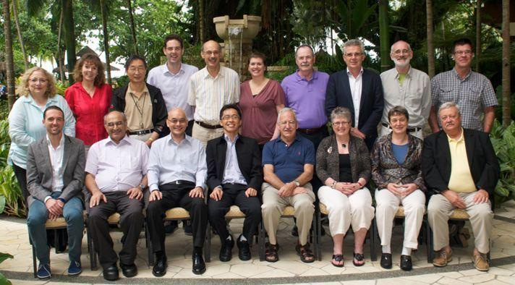
Broader coverage does not mean lower standards
内容的广度并不意味着要降低标准
Scopus收录期刊的挑选工作由国际第三方权威独立机构‘内容甄选委员会’ Content Selection & Advisory Board (CSAB)
Scopus通过第三方权威机构来进行收录内容甄选，可以做到:
可以让用户获取更为准确和有用的搜索结果 严格的收录标准保证Scopus内容的权威和高影响力 完善的同行评议机制保证Scopus内容收录的真实可靠

Slide 17
Scopus内容的收录标准
Eligible titles are reviewed by the Content Selection & Advisory Board according to a combination of 14 quantitative and qualitative selection criteria:
All titles should meet all minimum criteria in order to be considered for Scopus review:
Journal policy | Convincing editorial concept/policy Level of peer-review Diversity in geographic distribution of editors Diversity in geographic distribution of authors
Quality of content | Academic contribution to the field Clarity of abstracts Quality and conformity with stated aims & scope Readability of articles
Journal standing | Citedness of journal articles in Scopus Editor standing
Regularity | No delay in publication schedule
Online availability | Content available online English-language journal home page Quality of home page
Minimum criteria
最低限度标准
Peer-review 同行评议
English abstracts 英语摘要
Regular publication 定期出版
References in Roman script
拉丁文字的参考
Publication ethics statement
出版伦理的声明
Info 消息 : http://www.elsevier.com/online-tools/scopus/content-overview
Questions 疑问: titlesuggestion@scopus.com
Notes:
All titles should meet all minimum criteria in order to be considered for Scopus review.
Eligible titles are reviewed by the Content Selection & Advisory Board according to a combination of 14 quantitative and qualitative selection criteria.

Slide 18
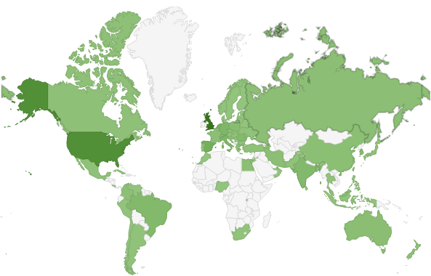






Scopus期刊的评估结果
In total 3,683 titles reviewed of which 1,761 (47%) accepted for Scopus (2011 – 2013)
Titles reviewed from top 20 countries:
Advice from CSAB and FAQs available on Scopus info site
Publication ethics resources via Publishing Ethics Resource Kit (PERK) and Committee on Publication Ethics (COPE)
Elsevier.com Editors section (for ELS editors but applicable to all)
Accepted 接受
Rejected 拒绝

Slide 19
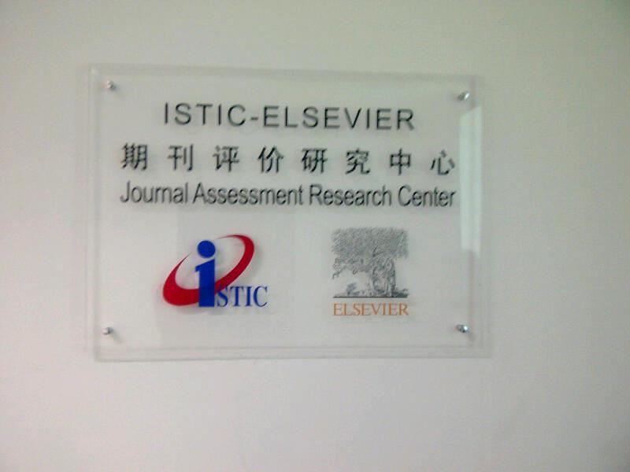
Notes:
Collaboration is two fold:
1- Enhance China’s opportunities in bibliometric research by measuring Chinese research output.
通过评估中国科研产出，加强与中国的文献计量学研究合作
2 – The Expert Content Selection and Advisory Committee of China (ECSAC-China)
中国专家内容选择与顾问委员会

Slide 20
Scopus的功能介绍

Slide 21
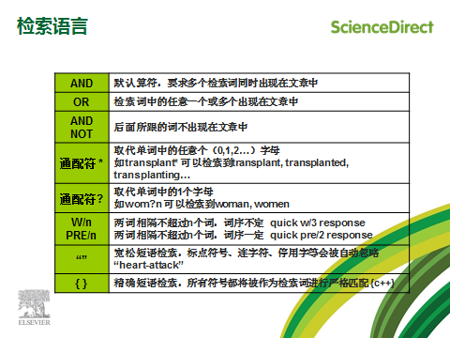
检索语言

Slide 22
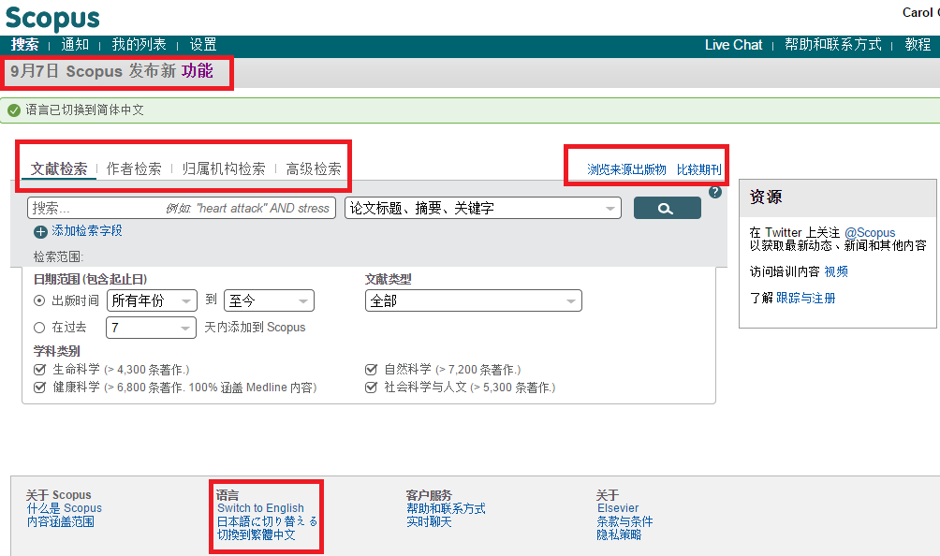
中文页面
新功能提醒
期刊对比和分析
语言切换
Notes:
2014年六月份推出中文简体页面，中国的用户使用更加方便。

Slide 23
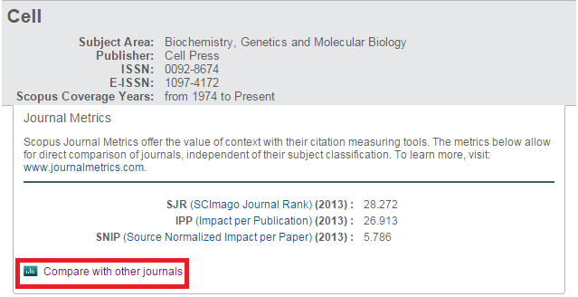
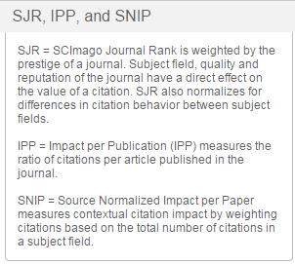
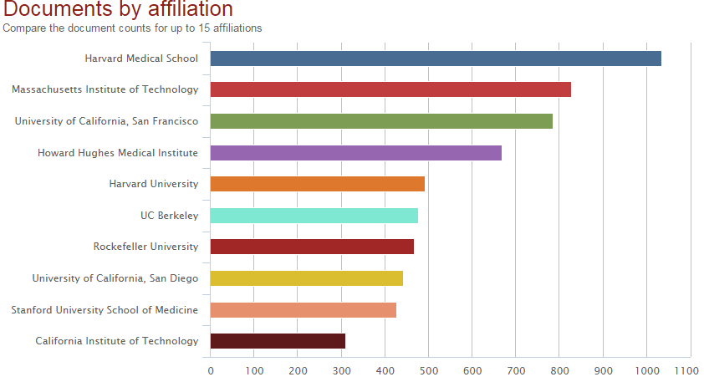
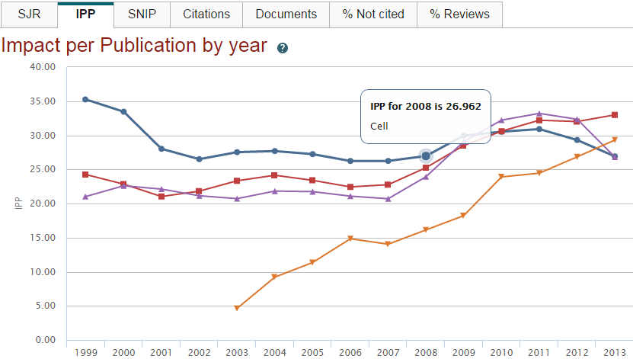
期刊对比分析Compare Journals

Slide 24
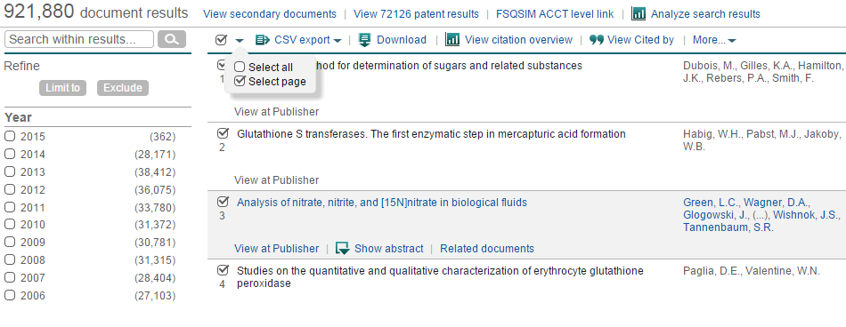
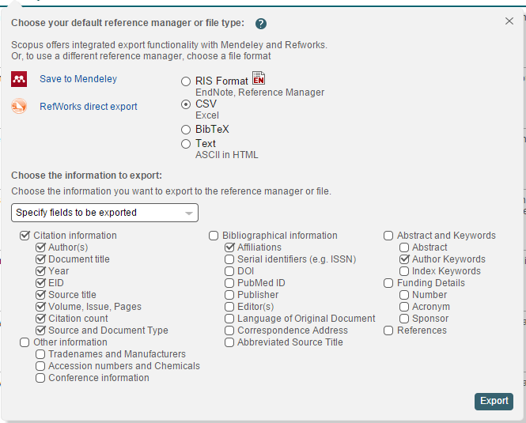
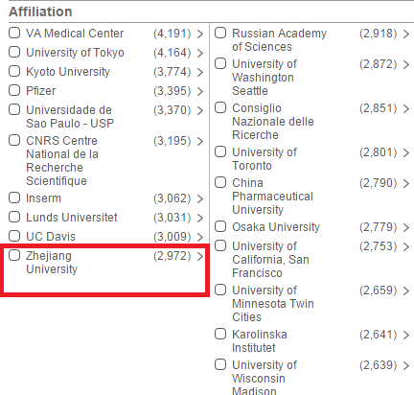
主题检索结果—chromatography

Slide 25
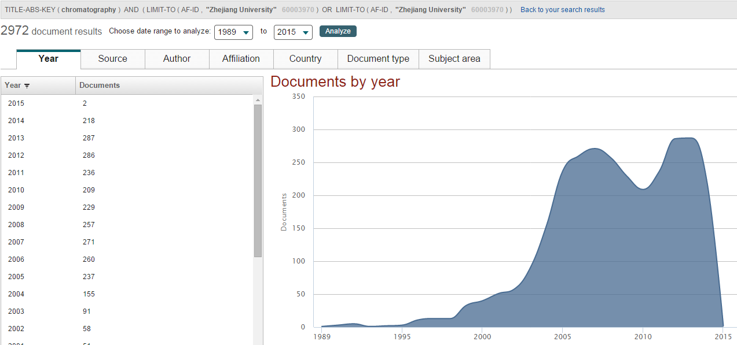
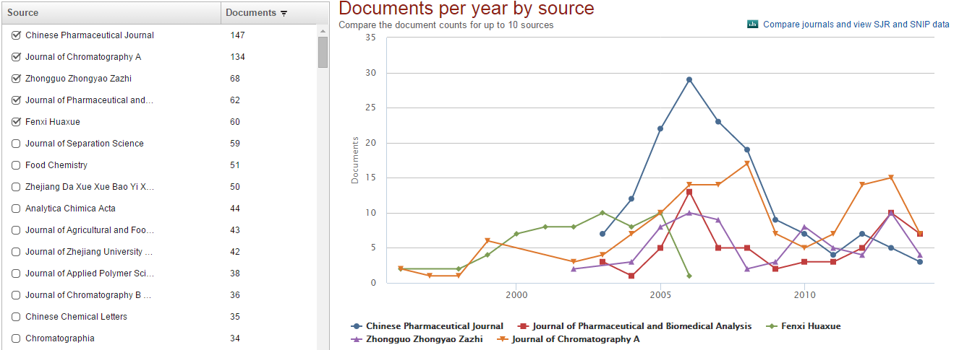
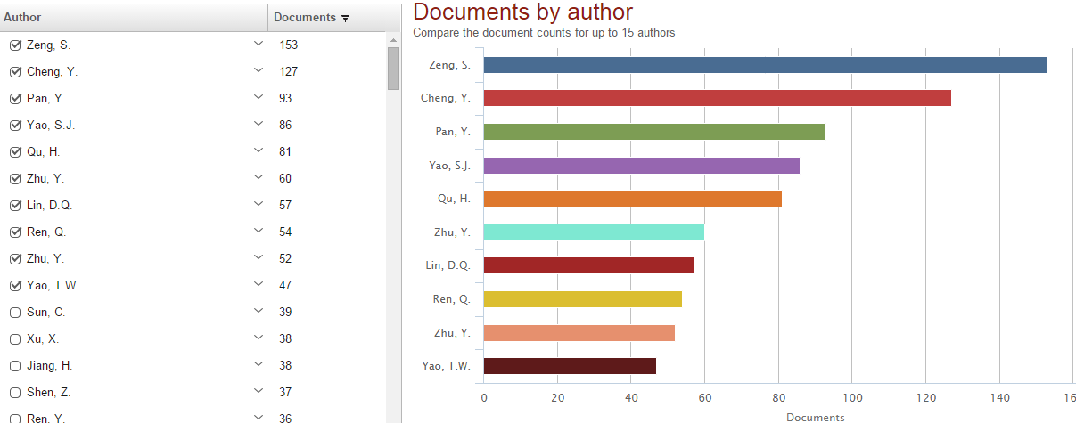
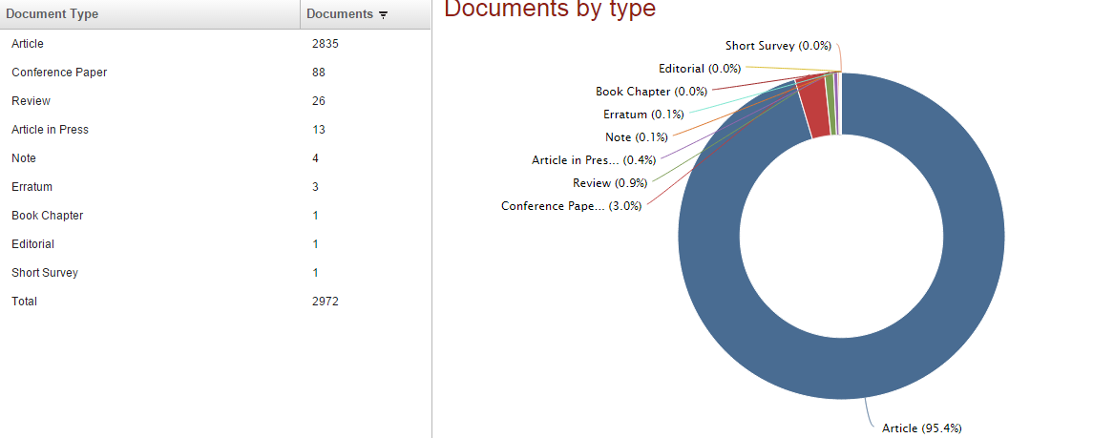
主题+机构检索结果分析
分析机构在chromatography·领域的整体表现。

Slide 26
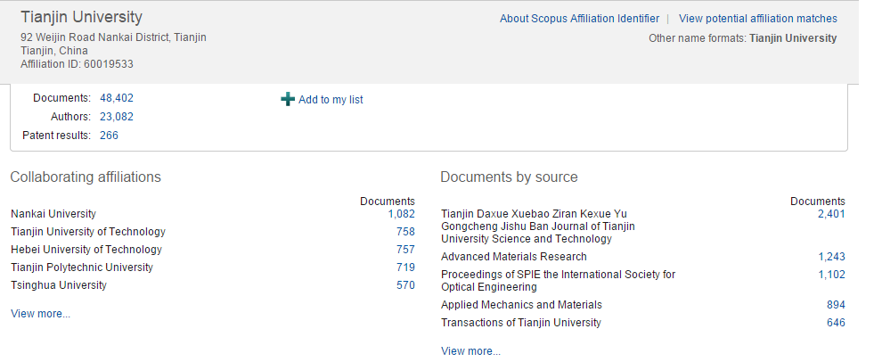
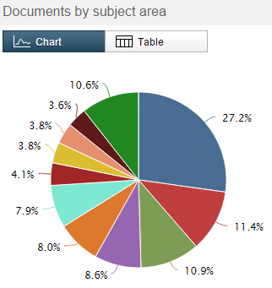
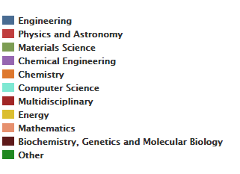
机构检索结果分析

Slide 27
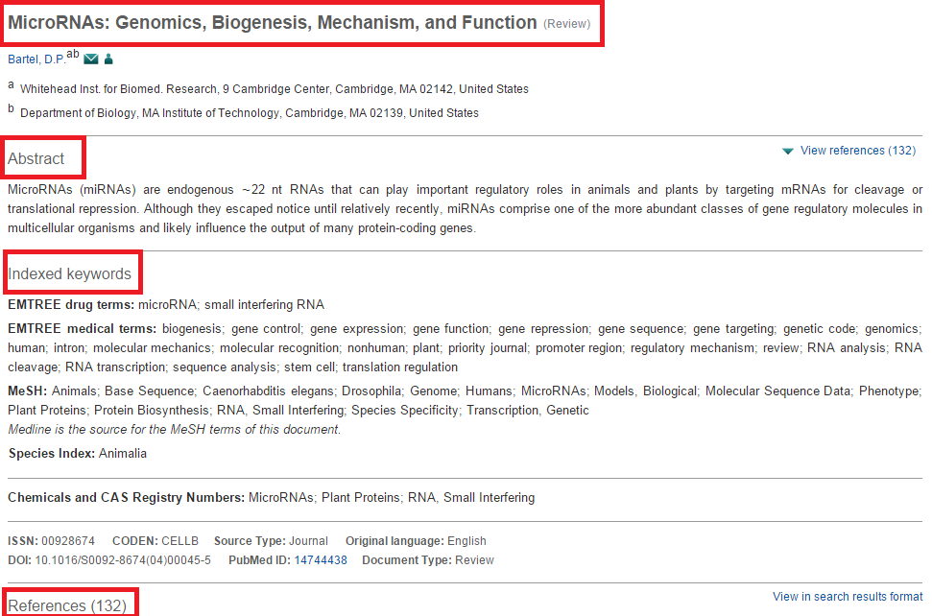
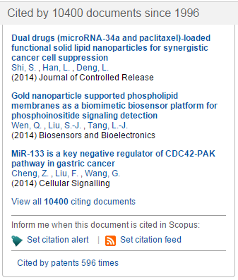
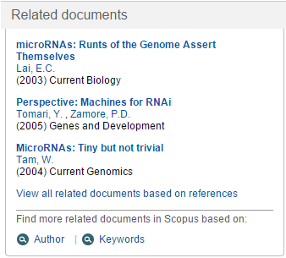
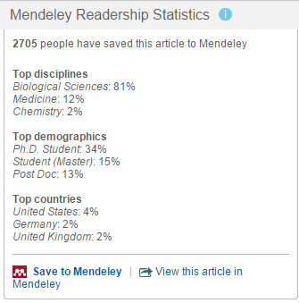
文章分析

Slide 28
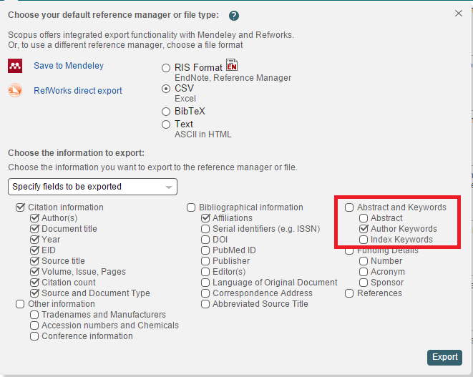
CSV保存格式

Slide 29
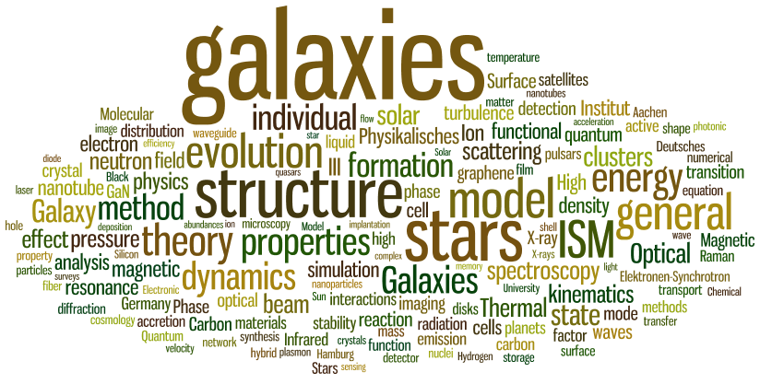
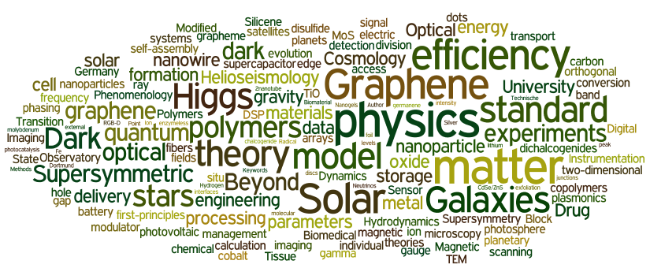
学科领域现状与前沿分析——北京大学实例
北京大学物理领域2012年主要作者关键词
全球物理领域2012年热门作者关键词
Notes:
愿景：Snowball Metrics提高高等教育机构科研工作与企业（即经济发展）活动的质量与效率，以实现全球基准比较，覆盖不同系统与供应商

Slide 30
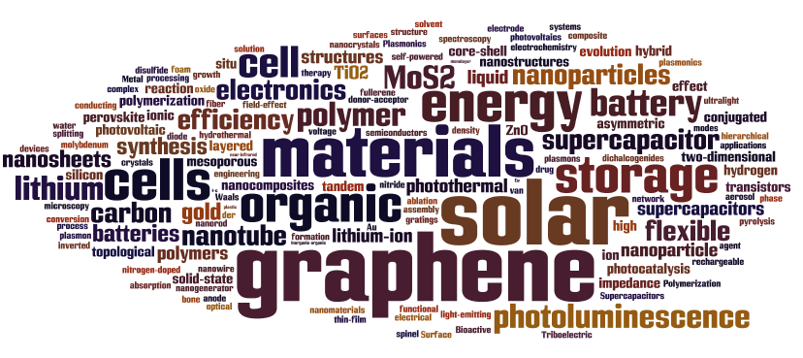
材料科学热点分析——2013

Slide 31
总结热门研究方向
2013年最热门材料科学研究主题有：
石墨烯材料相关研究：2010年诺贝尔物理学奖获得者的主要研究方向，最近几年来石墨烯材料的研究一直是材料方向的热门领域。在前200篇文献中出现22次。
纳米管材料相关研究：纳米管作为新一代氢气容器，模具和复合材料的重要的基础，近年来一直比较热门。在200篇文献中共出现10次。
光致发光材料相关研究：光致发光材料目前在安全方面上的应用是其最为普遍的，现在光敏感材料在光电子领域应用也逐渐兴起。在200篇文献中共出现9次。
聚合物材料相关研究：高分子聚合物研究在材料科学领域一直以来传统热门领域。在200篇文献中出现20次。
太阳能电池材料相关研究：太阳能发电装置的材料研究致力于更高的光能转换效率和更低的成本，是新能源材料领域的前沿。在200篇文献中出现20次。
锂电池新材料相关研究：随着电动汽车逐渐走入民用领域，锂电池新材料的研究日渐引起科研和产业界的关注。200篇文献中共出现14次。

Slide 32


人名清理和人才评估
Many researchers that too closely resemble one another.
Researchers publish under name variations.
Dr. Wang
Dr. Wang
Dr. Wang
Dr. Wang Fei-Yue
Dr. F. Wang
Dr. Wang F.Y.
Notes:
The Challenge: Scholarly Name Ambiguity
作者管理的挑战：重名辨识

Slide 33
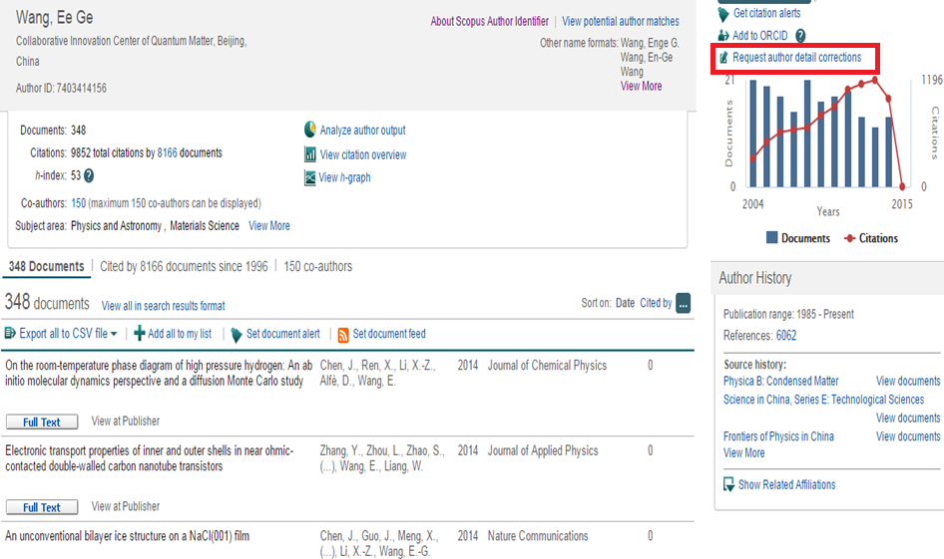
Scopus Author Profiles 作者概览和分析
Notes:
Request author detail correction

Slide 34
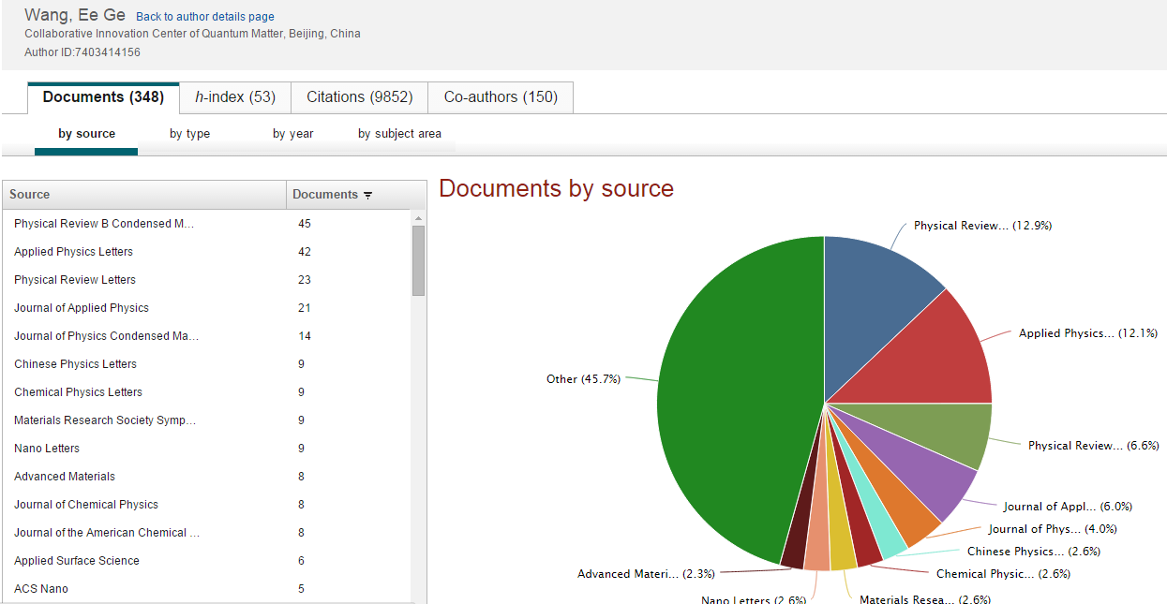
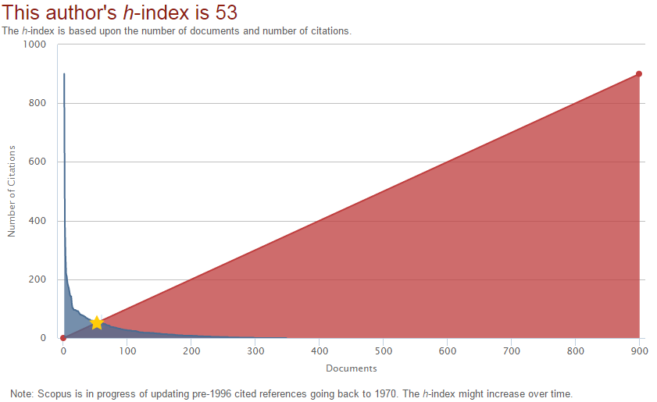
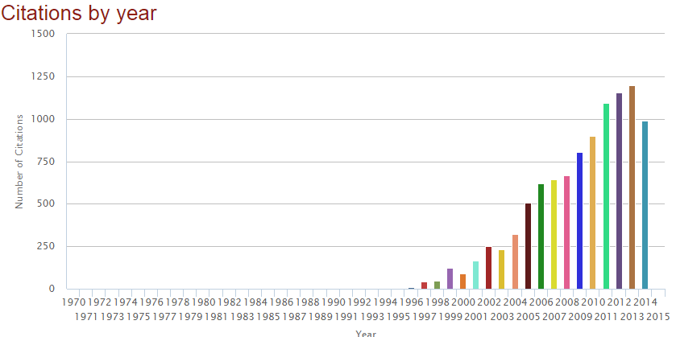
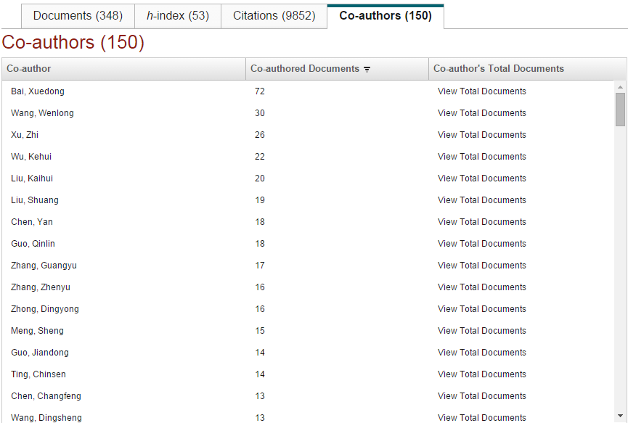
Author Evaluator 作者评价分析功能

Slide 35
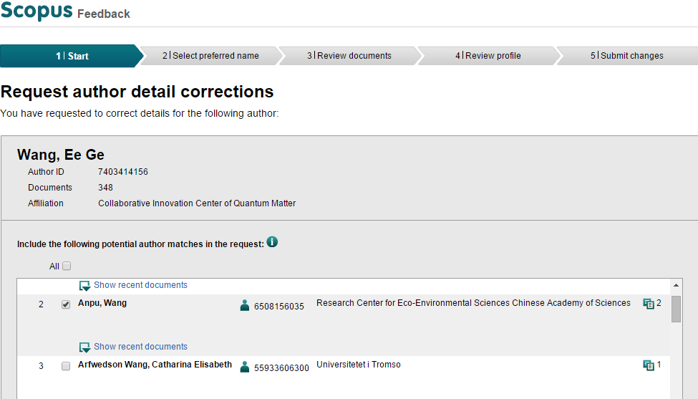
Scopus页面支持作者进行人名清理
Request author details correction

Slide 36
学者分析
Total Publication | Pub 96-12 | Citations 96-12 | H-Index 96-12 | Pub 08-12 | Citations 08-12 | CPP 08-12 | Intl Collab 08-12 | FWCI 08-12 | Top 10% 08-12
488 | 465 | 21228 | 79 | 110 | 2576 | 23.4 | 13.60% | 3.25 | 18.20%
数据解释如下：
Total Publication – 历史总发文数量为488篇
Pub 96-12 – 1996至2012年的总文献量为465篇
Citations 96-12 – 1996至2012年发表文献至今的总被引次数为21228次
Pub 08-12 – 2008至2012年总发文量为110
Citations 08-12 – 2008至2012发表文献至今的总被引次数为2576次
CPP 08-12 – 2008至2012发表文献至今的篇均被引为23.4次
Intl Collab 08-12 – 2008至2012发表文献的国际合作比率为13.6%
FWCI 08-12 – 2008至2012年发表文献的归一化影响因子为3.25，含义为3.25倍于世界平均水平
Top 10% 08-12 – 2008至2012年发表文献在全球前10%高被引文献的比率为18.2%

Slide 37
sginfo@elsevier.com
+86 10 85208765
提供中文电话服务

Slide 38
Thanks！
www.scopus.com

