Slide 1
Freemium Open ACcess The OECD Model
Presentation at CALIS/DRAA
May 2015

Slide 2
About the OECD
Mission:
to promote policies that will improve the economic and social well-being of people around the world;
provide a forum in which governments can work together to share experiences and seek solutions to common problems.
measure, analyse, compare data, and set standards to predict future trends on a wide range of things.
recommend policies designed to make the lives of ordinary people better.
Notes:
OECD is not a publisher in the traditional sense as understood by a library. We are an Inter Govt Organisation, formed for the purpose to study socio-economic issues and provide policy recommendations for our member governments.
As such, publishing is not our objective, it is a by-product of our work. You will find that we do not accept external manuscripts for publishing and we do no aggregate or regurgitate any third party content within our knowledge base. All OECD publishing is based on proprietary OECD first hand research.
In some cases we do joint work with other agencies like WTO, World Bank, FAO, G20 and in such we have co-credits for our output. In other cases, we quote some 3rd party statistics in our review and reports. Other that these collaborative situations, all the content in the OECD knowledgebase are worked on by OECD funded teams and are unique and proprietary.

Slide 3
OECD researches various area
Agriculture and fisheries Bribery and corruption
Chemical safety and biosafety Competition
Corporate governance Development
Economy Education Employment
Environment Finance
Green growth and sustainable development
Health Industry and entrepreneurship
Innovation Insurance and pensions
International migration Internet
Investment Public governance
Regional, rural and urban development
Regulatory reform Science and technology
Social and welfare issues Tax Trade
Notes:
OECD is most well known for Economics, as seen in our organisation name, but we are more than just Economics. We have many subject areas and whilst many of the projects and reports are well known, it is not always clear that these are in fact OECD driven projects and the outcomes are and part of our Knowledgebase.
Here is a snapshot of some of our subject areas.

Slide 4
Current OECD initiated topics
PISA:
Evaluate education systems worldwide by testing the skills and knowledge of 15-year-old students
Base Erosion and Profit Shifting:
G20 initiated project to understand the extent of large MNCs avoiding tax and to address the issue
Inequality and the Middle Income Trap:
Fragmentation of Society, the Rich getting Richer, the Poor receives help, but the Middle Income faces increasing stress to maintain and improve their lifestyles
Notes:
Here are some new topics that will be familiar to you. You may or may not be aware that these are in fact OECD initiatives:
PISA - Education and the measurement worldwide education systems’ effectiveness in imparting of 21st Century Skills to its school leaving youth.
BEPS - Fairer Taxation for Countries and Tax Jurisdictions, by understanding and managing the conscious shifting of profits and tax obligations of large corporates who operate in a multi-national and multi-jurisdiction environment.
And of course, Economics latest challenge of increasing societal inequality, and the increasing friction caused by economic fragmentation.

Slide 5
About OECD iLibrary
OECD iLibrary:
Repository for all OECD output across all Directorates
Increase usage for OECD content via increased visability and improved usability
•9 670 ebook titles
•39 200 chapters
•85 400 tables and graphs
•4 000 articles
•4 000 multilingual summaries
•4 360 working papers
•3 640 key tables
•5 billion data points across 42 databases
Notes:
Here is a snapshot of our content specifics within the ilibrary portal.
Let me close by sumarising:
OECD content is unique, proprietary and first hand. We create all our content ourselves and we do not re-publish, aggregate or re-gurgitate third party content.
We are well known for Economics, but our coverage is far more than just Economics. Because of our nature in addressing social issues, we often have the earliest knowledge output on fast moving and current global topics.
Our output is based on peer review and created by seconded subject matter experts with both internal and external viewpoint catered for.
We are a non profit organisation. Our objective in publishing is dissemination. Some of our content is provided free and also some of our services. But for our full range of content under full services, we recover the costs by charging a subscription fee. Unlike some societal non profit organisations, publishing revenues does not fund scientific work, it only funds our publishing value add. That is why our fees are relatively low and we provide additional discounts in many non profit usage environments.
Since 2012, India is a partner economy of the OECD. Whilst you are not yet a full member and your Government is not funding our overall work, there is a bilateral MOU between our organisations, and we closely collaborate across a wide spectrum of issues and projects. There is a very high degree of cross relevancy in our knowledge for India and Indian readers

Slide 6
Directives and Directions
Council
Oversight and Strategic Direction
Committees
Secretariat
Discussion, Monitoring and Peer Review
Research, Analysis and Policy Recommendations
Notes:
This is how the OECD works……there are 3 parties who look at different aspects of the total task.
Council
One representative per member country, plus the European Commission
Defines priorities and strategic orientations
Decisions are made by consensus
Committees
Approx 300 committees and working groups consisting of between 25000 – 40000 domain specific experts from member, partner and observer countries
Covering every area that OECD works in
Secretariat
Independent and unbiased
Provides analysis and support for member countries’ policy discussions

Slide 7
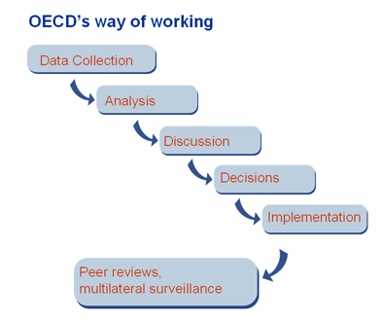
Methodology

Slide 8
Peer review
Examination of country policies and practices by experts from other countries
Effective tool for policy improvement thanks to:
Peer pressure
Common methodology and criteria to assess performance for all countries
Systematic monitoring mechanism
Peer learning and capacity building
Notes:
A short summary of our peer review policy……..we almost always conduct research and produce outcomes in committees, never by individuals. We never allow only experts from1 country to provide output for their own country. We always have a mix of external experts and we always allow the voice of at lest 1 internal expert when we produce country specific outcomes. Debate and consensus is a key part of our process, and outcomes are always reviewed and feedback generated for the next review cycle.

Slide 9
Reliability of the OECD Data
All of the OECD’s data are submitted from the governments of OECD member and non-member countries.
In order to make them internationally comparable, the OECD sets up the international standards for collecting statistics cooperating with the United Nations and Eurostat. (ex. Standard International Trade Classification (SITC), International Standard Industrial Classification of All Economic Activities (ISIC) )
The governments collect statistical data in their own countries by such standards, and submit to the OECD.
Notes:
Statistical Data is collected from National Sources on bilateral agreement basis. That is to say there is a contractual agreement to deliver timely information and in the form and format proposed by the OECD. OECD has setup standards for such data to ensure that the data is harmonised and comparable.

Slide 10
Challenges: Discoverability and Usability
Create publishing metadata at more granular level so that smaller and more relevant pieces of information can easily be searched and found, whether data or analysis.
Create statistical metadata so that the numbers are never delivered without the textual environment making them understandable and usable.
Link, as much as possible, analytical content to the statistical evidence supporting it.
Deliver the content in the most user-friendly environment (citation tools, links to the context of each object, multiple formats).
Adapt content to the different platforms and reader environments.
Increase content index coverage
Notes:
Next, I will spend a few slides to showcase some of the unique features of OECD content via our ilibrary platform. I will discuss the rationale behind the development of these features, and I will talk about some of the internal challenges that the OECD has faced in terms of preserving and presenting knowledge.
We are a Non Profit Organisation and our Research is fully funded by membership dues from member countries, and there are internal questions as to whether we should provide access to our knowledge for free under Open Access. Currently we operate on a “Freemium” subscription model, whereby some of our full feature content is available for Open Access, and more content which are not full function enabled, are available under read only access with no download or inherent re-use rights. However, complete access to all the repository of all the content, with download rights and full linking features, in the various publishing formats, for unlimited site wide access, is only available under a subscription basis.
Here is or rationale behind our Freemium model:
The objective of the Publishing Unit is to maximise dissemination of our knowledge. Putting aside the argument that non member countries do not contribute towards the funding of the actual research work, our aim is to have our knowledge widely accessible, so that we can present our recommendations to a greater audience for the betterment of the global community.
We have come to believe strongly, that totally free content with no usage support, left to its own devices on the Internet does not result in increased usage or dissemination.
In order to make content useful and widely accessed, content needs to be discoverable and usable. The Publishing unit of the OECD, puts value added services into the raw manuscripts and statistical items that we receive from the Project teams and the Directorates.

Slide 11
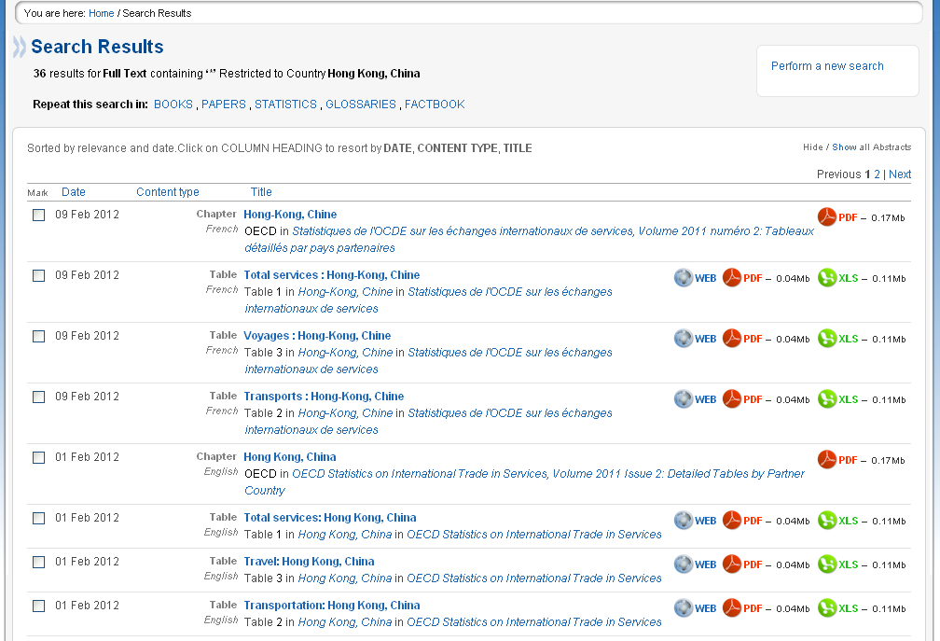
Country search
Deep Indexing for Chapters and objects within the reports
of your convenience.
Different Formats for same content
Notes:
In this sample page from a Country Search, you can see 2 key value add publishing activities:
On the right side……you will see different downloadable formats for the same content. We publish the same basic content in different formats, Web HTML, PDFs, Excel, ePub etc etc. This allows the content to be read and downloaded in the format that best suits the user needs and usage environment. Different formats have different usage feature pros and cons.
In the middle box, you can see different objects listed as hits in our sample search. We have indexed our content deeper with DOIs at a more granular level. A large report of several hundred pages, is now indexed with DOIs at the chapter level, and at each object level, that is, each chapter, table, graph or chart, is an independently searchable and discoverable item separate from the report in its entirety. These objects are hits in themselves and can be viewed independently.

Slide 12
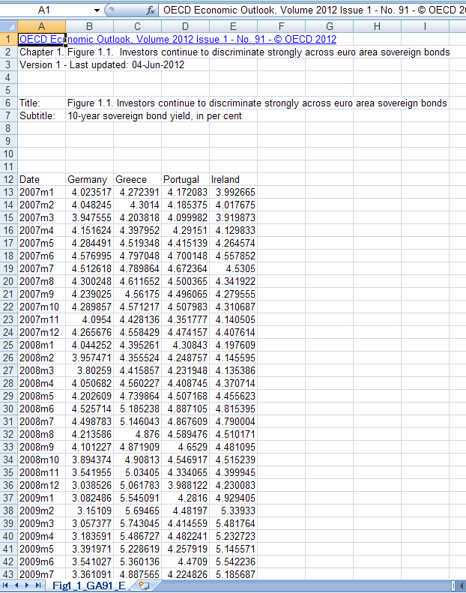
StatLink
Downloadable excel for OECD collated Tables and Graphs
Notes:
Within the reports, wherever there is a table, chart or graphical representation, where the data is collected by the OECD, for which we have the Intellectual rights, we provide a direct link which is downloadable in Excel format. This means that Subscribers will not have to copy and paste references but can work directly with OECD statistics in manipulating and modifying our stats. Needless to say this saves tremendous tie and effort for users of our content.
Downloaded stats always refer to their source report and contains a link back to the original document so the context of the statistics is always preserved.

Slide 13
Interactive Database - Ex. OECD Education Statistics
Notes:
Besides the statistics which are commonly used and requested, we provide our subscribers with full interactive access to our complete 5 billion cell virtual spreadsheet.

Slide 14
Customise selection
Custom Query Interactive Stats
Notes:
Subscribers can create their own custom queries, by changing the variables to any given combination that suits their purpose, they can change the layout of the tables to present the data according to their focus and intent. And all these customised re-creations can be downloaded and taken away for offline use. With citations and citation tools already embedded.

Slide 15
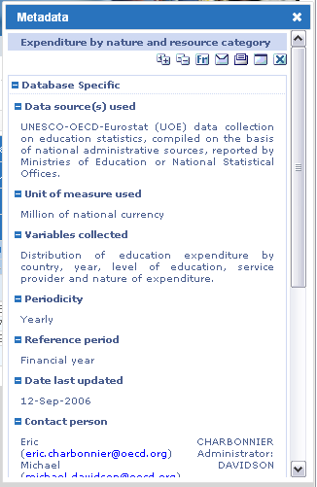
The table completed!
Context based metadata
Notes:
For Statistics, the strength of the OECD is the deep methodology and the detailed documentation of this. Subscribers get access to all our statistical metadata, so that numbers are always delivered together with the contextual environment, to make them more understandable and usable.

Slide 16
A Story about the birth of a book
Notes:
This is the story of the 2010 Migration Outlook…the numbers quoted are based on factual findings from this publication and this story is typical for all Publishing Dept produced items

Slide 17
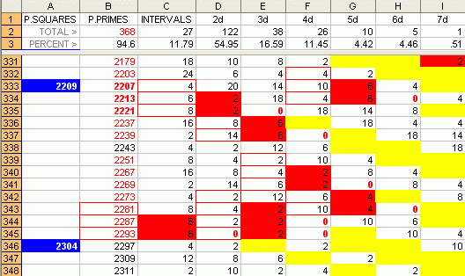
Turning one manuscript into a book
Free Online Views (Online Bookshop ‘Look Inside’) 5129
Portal
Committees & Directorates
FREE
Downloads (E-book) 1492
Downloads (e-chapters) 1102
Downloads (tables and graphs) 5870
Downloads (summaries) 472
Free Views (Google Books) 1178
15243
E-books
Print copies
1244
Notes:
In the beginning was the Word (document) . . .
The first step is upstream work with the PAC Editors – advising on structure, style and making sure we have a readable summary and abstracts for every chapter.
Once accepted (and it is not a given that manuscripts will be accepted) it passes to pre-media where the raw manuscript is captured, graphics are prepared and pages are laid-out to the OECD style and checked.
Then the book is printed and distributed – in this case, 1244 printed copies have been delivered or downloaded.
We’ve turned the manuscript into a Book. But that’s just the beginning of the story . . .
Using the same file, an e-book is also distributed via our own online bookshop and via other e-book sellers
The same file is also loaded onto OECD iLibrary and made available to end-users at subscribing institutions
So far, so ordinary . . . But now we really start adding value
First, we break the book into its chapters, wrapping each with discovery tags (metadata) and load them onto iLibrary
Then, using the original data files, we use our data editors (unique to OECD) to create StatLinks, load them onto iLibrary – (you can see why we won an award for publishing innovation with this service – and it remains unique to us)
We’re not done yet, we then translated the summary into 21 languages (including Chinese & Russian)
And posted free-to-read editions on Google and our own websites.
We’ve turned a manuscript into a Portal – and reached a much larger audience – 15,243 downloads. You can see that at each step of the value added process, dissemination has increased.
And so…we do not simply print what the directorates write... And have in many ways pioneered online publishing within the OECD through our various value added activities and delivered these within a mix of free and paid-for services

Slide 18
Turning one manuscript into a book
Free Online Views (Online Bookshop ‘Look Inside’) 5129
Portal
Committees & Directorates
From one manuscript
Today
Downloads (e-chapters) 1102
Downloads (tables and graphs) 5870
Downloads (summaries) 472
Free Views (Google Books) 1178
Downloads (E-book) 1492
Create, manage & publish 236 items
Before
E-books
Print copies
1244
Create, manage & publish 1 item
Notes:
To sum up,
We received one manuscript and, before, we would have turned this into one printed book.
Today, we receive one manuscript and create, manage and publish 236 items to create a portal.
So, even if we hold the argument, that the basic content is provide free because we are publicly funded, and remember only member countries pay for the research. Then in order to make the content usable, someone still needs to pay for the publishing value add activities.
Today, OECD receives an internal annual grant of about Euro 5 Million for publishing activities. Subscriber fees helps us to cover our overall annual publishing maintenance cost budgeted at Euro 17 million.

Slide 19
Learning to let go . . . or
How Freemium could be a fairer and more sustainable version of OA

Slide 20
Most-read by STM publishers?
“Every successful brand in history is inherently unpopular with a specific demographic.”
“Somewhere along the way, people felt they had to be popular in order to be successful, when in fact, the opposite is true.”
✗
“The brands playing in the space you want to dominate have already figured out the inherent power of being unpopular.”
(Published by Wiley)

Slide 21
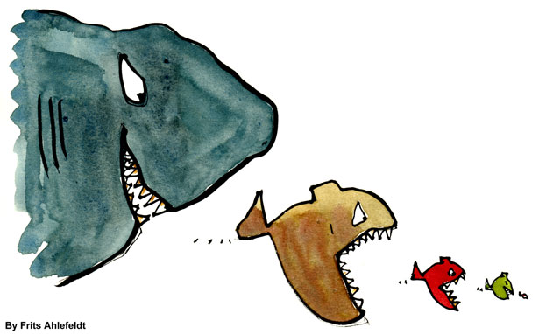
Do we know our audience . . .?
“The audience which finds your content interesting and useful is always larger than you think.”
Practitioners, unaffiliated researchers, educated layman . . . .
Students
Researchers
Authors

Slide 22
More graduates = more demand for scholarly publications
a
%
But they won’t all work in subscribing institutions
Average
Source: OECD (2014),Graph A1.3. Percentage of younger and older tertiary-educated adults (2012): 25-34 and 55-64 year-olds, and percentage-point difference between these two groups, in Education at a Glance 2014, OECD Publishing. DOI: 10.1787/eag-2014-graph3-en

Slide 23
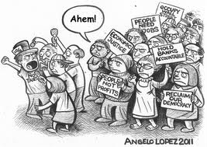
. . . so, no wonder they’re calling for better access . . .
No! You have to subscribe to knowledge!
I PAID MY TAXES
OPEN ACCESS NOW
HOLD PUBLISHERS ACCOUNTABLE
I NEED RESEARCH FOR MY START-UP
RECLAIM OUR RESEARCH

Slide 24
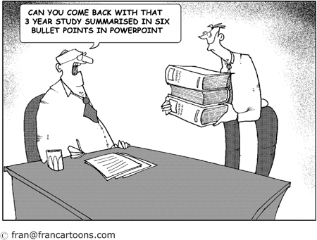
. . . and the policymakers and funders are listening . . . and acting . . .
What do you mean, these reports cost money? We paid for the @*^%$ research!

Slide 25
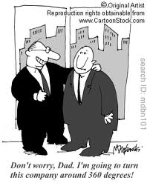
. . . so publishers are reacting . . .
Don’t worry, Dad, I’m going to turn this company around 360 degrees!

Slide 26
. . . by turning their attention to authors (and their funders)
. . .at the risk of ignoring the needs of . . .
READERS
(and their institutions)
Practitioners, unaffiliated researchers, educated layman . . . .
Students
Researchers
Authors

Slide 27
Open Access – find the missing words
“If you make it open . . . they will come”
readers
books
data
mandates
movement

Slide 28
Open Access Mandates
“Thou shall deposit . . . and it will have impact”
dissemination
readers

Slide 29
Open Access business models summarised
Green
Please post a version in a repository
Sometime later will do
I hope a lot of readers will benefit (although I have now given them a horrible user journey and taken away their economic ‘voice’)
I don’t want to think about costs (or the impact it may have on journal or book publishing on which my reputation and career depends)
But my conscience is clear
Gold
I’ll foot the publishing bill
I hope a lot of readers will benefit (although I have now taken away their economic ‘voice’)
I don’t want to think about future costs
But my conscience is clear
And 20 years on from Budapest, <50% of journal articles and <5% of scholarly books are free to read.
Will Green and Gold ever deliver 100% OA?

Slide 30
OECD Publishing’s mandate
MAXIMISE DISSEMINATION
(i.e. everything has to be free)
FULL COST RECOVERY
(i.e. everything needs to be priced)
?
?
?
?
$16.5M
Accountable to our members on both mandates
Notes:
To remind audience that
the mandate is Part I statistical data only.
No mandate or commitment on publications
We will continue to sell, including statistical data services
Publishing Policy is unchanged save for the commitment that 100% of Part I data be freely available in basic form

Slide 31
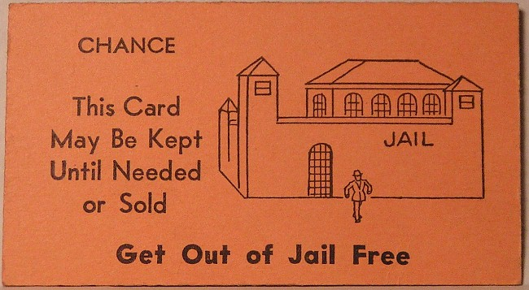
So, how do we stay out of debtors’ jail?
By using a:
Freemium Open Access business model

Slide 32
Freemium ?
freemium
NOUN
A business model, especially on the Internet, whereby basic services are provided free of charge while more advanced features must be paid for.
Origin
early 21st century: blend of free and premium.
. . . and a common digital media business model
http://www.oxforddictionaries.com/definition/english/freemium

Slide 33
Freemium is all about audience building and offering the option of moving up a value path
Therefore, audience-building is at the heart of Freemium Open Access
To have enough of these . . .
Registered Free
Anonymous Free
Anonymous Paid
Registered Paid
. . . you need loads of these.
The Audience (formerly known as readers)

Slide 34
Freemium – it’s about the value proposition
A business model, especially on the Internet, whereby basic services are provided free of charge while more advanced features must be paid for.
 | Free Anonymous | Free Registered | Paid Anonymous | Paid Registered
Discover and Read all content | ✓ | ✓ | ✓ | ✓
Share, embed content | ✓ | ✓ | ✓ | ✓
Personal services (e.g. alerts) |  | ✓ |  | ✓
Download, cut/paste content (PDF, ePub etc) |  |  | ✓ | ✓
Librarian services |  |  |  | ✓

Slide 35
Freemium must innovate and evolve
PREMIUM
Innovation
Complex
Support for libraries
FREE
Save offline, copy-paste
Text mining
Enhanced discovery
Save in information management systems
Read on tablets
FREEMIUM
Citation tools,
Needs
Download associated data (StatLinks)
Personal services
Share, Embed
Basic discovery
Read on PC
Simple
Time
Notes:
Key message: Delta continues the existing practice of stepping up the value chain to find revenues and using these revenues to build improved free services to non-subscribers.
This is why Freemium model can work: As new needs emerge, new, innovative, premium services are provided generating the revenues to enable mature services to become free.

Slide 36
But my audience is too small!
Remember me?
Practitioners, unaffiliated researchers, educated layman . . . .
Students
Researchers
Authors

Slide 37
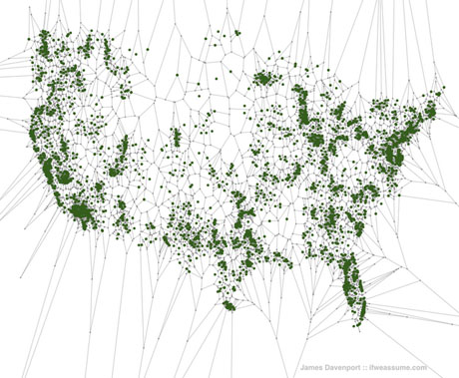
Audience building – how?
How can we get OECD content into everyone’s online neighbourhood and workplace?
Did you know 33% of Americans live within 1 mile of a Venti Latte?
(And even the most isolated American is just 140 miles away).
Source: Edible Geography http://www.ediblegeography.com/the-spatial-distribution-of-americans-in-relationship-to-starbucks/
Notes:
Did you know that 80% of the US popularion live within 15 miles of a Starbucks and no-one lives more than 140 miles from a Venti Latte?
Just as Starbucks (and WallMart and IKEA and McDonalds . . even Apple) actively take their message to market and build distribution channels and outlets close to their target audiences, so must OECD. Can we get 80% of our audience within three clicks of our publications?

Slide 38
By doing all the usual discovery stuff . . .
Source: Gardner and Inger (2012): How readers discover content in scholarly journals
Notes:
Gardner and Inger research reader behaviour among academic and high-level student audiences. They found that academics start their research for scholarly information in eleven places. A post-it and hope strategy would miss 85% of the starting points and signposts used by this audience – PAC covers almost all of these by actively posting metadata and/or full text content into these channels. The result is 122,000 referrals to OECD’s publications a month, 24% of all traffic to our publications.

Slide 39
. . . and using many delivery channels
For professionals . . .
. . . and the public
Notes:
Other audiences are no different, they each have different online ‘forests’ where they go to find information – this is especially true among professional audiences – law, finance/banking, tax – and more recently policymakers with the launch of Bloomberg Government aimed squarely at those within the Washington Beltway last year.
For non-professional audiences (citizens and civil society activists) we use consumer channels like Google Books, Amazon and Scribd.
And all the while, PAC is actively using social media to promote and enable audiences to engage, to participate.
Just as Starbucks opens close to their customers and uses social media to build audience share, so OECD does the same.
And the results are good – around 360,000 readings a month via these non-OECD channels.

Slide 40
But we have also learned to let go
we now encourage anyone to read and then share and embed our publications in their websites and blogs for free

Slide 41
Non-subscribers can purchase the premium versions too
All the content is free to Read
Subscribers get access to the premium versions (PDF, ePub, Excel)

Slide 42
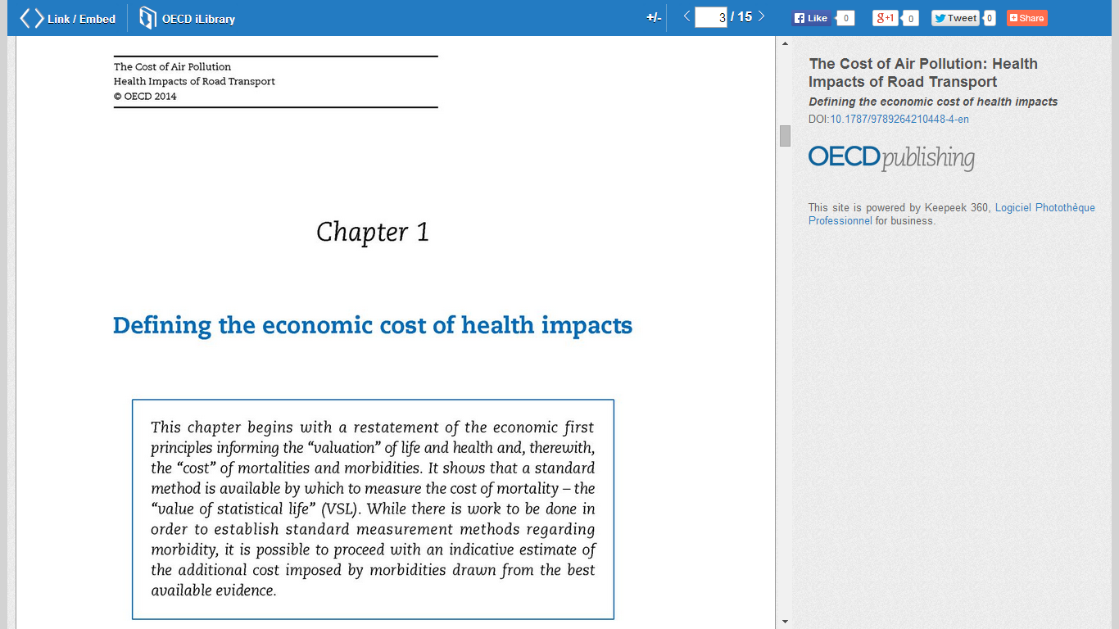
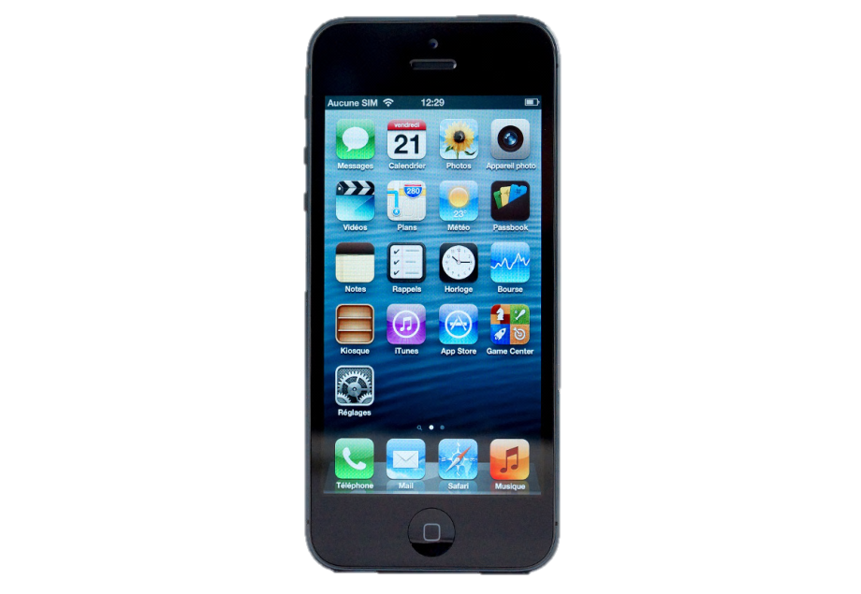
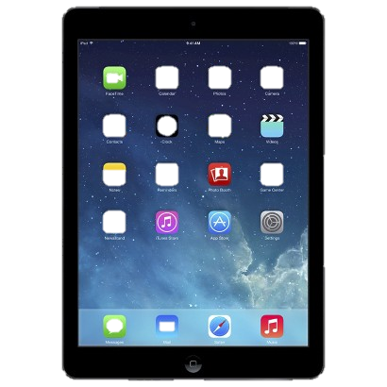
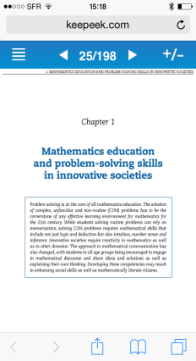
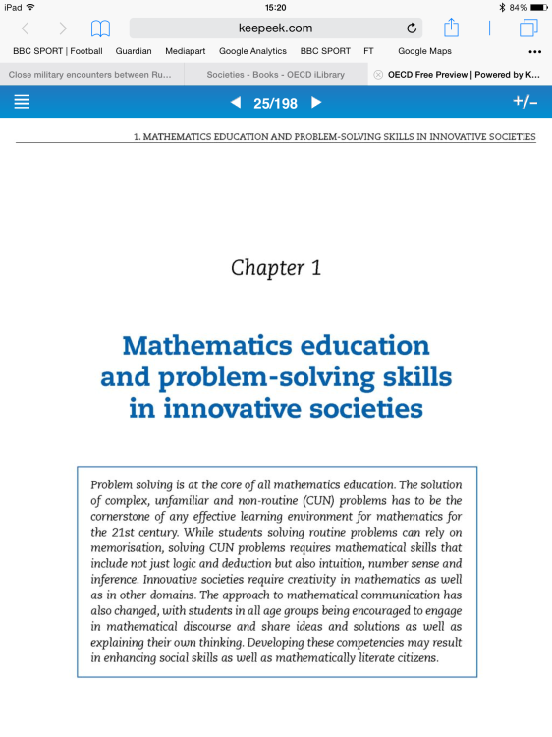
Read versions are optimised for all devices . . .
and then we let go . . .
Clicking ‘Link/Embed’ . . .

Slide 43
No permission or license required . . .
Because it’s embedded, we know it’s there . . .
. . . and we know the traffic too.
These buttons lead to the premium versions on our website.

Slide 44
Do we fulfil our mandates
On dissemination? On cost recovery?
And we recovered our (growing) publishing costs in every year too.
Dissemination (‘000)
Each colour is a different service or channel

Slide 45
iLibrary Counter based Global Usage updated til 23rd March 2015
Country | Parent InstitutionName | Parent RegistrationType | 2011 | 2012 | 2013 | 2014 | 2015
 |  |  | 1,987,201 | 3,147,324 | 6,527,065 | 8,663,859 | 2,149,736
United States |  |  | 13,880 | 17,492 | 108,852 | 75,054 | 3,096
United States | UN Consortium | Consortium Parent | 16,951 | 18,509 | 23,900 | 24,315 | 4,135
Belgium | Central Library of the EC | Master Registration |  | 12,294 | 18,882 | 21,947 | 4,794
Belgium |  |  | 10,606 | 14,663 | 18,889 | 20,492 | 2,985
United States | IMF WORLDBANK | Stand-Alone | 13,872 | 16,074 | 18,036 | 18,437 | 3,175
United States | Pennyslvania State University | Stand-Alone | 1,684 | 1,906 | 2,544 | 16,714
Brazil | CAPES OECD Consortium | Consortium Parent | 9,236 | 9,535 | 11,957 | 13,322 | 1,481
Brazil |  |  | 9,311 | 9,730 | 11,707 | 12,669 | 1,406
United Kingdom | London School of Economics and Political Science | Stand-Alone | 11,762 | 14,990 | 15,105 | 12,649 | 2,164
United States | Harvard University Libraries | Master Registration | 4,902 | 6,318 | 6,896 | 11,125 | 673
Czech Republic | University of Economics Prague | Stand-Alone | 8,942 | 9,949 | 11,768 | 10,627 | 1,156
United States | UNIVERSITY OF WASHINGTON | Stand-Alone | 1,433 | 1,609 | 1,837 | 10,245 | 381

Slide 46
In conclusion – Is Freemium a better form of OA?
Freemium means actively building an audience (You can be Free and not have readers)
Freemium keeps the audience in the driving seat (You can be Free and ignore reader needs)
Freemium means innovation (You can be Free and stop innovating)
Freemium delivers value for money (You can be Free and build services that no-one uses)
Freemium gives taxpayers/funders a choice (To be Free taxpayers/funders must pay)
Freemium is compatible with Gold – Funders can choose to make premium features free for everyone

Slide 47
Thank you & Questions?
Go Freemium Open Access!
And thanks to Banksy for the ‘letting go’ girl

